Slide 1

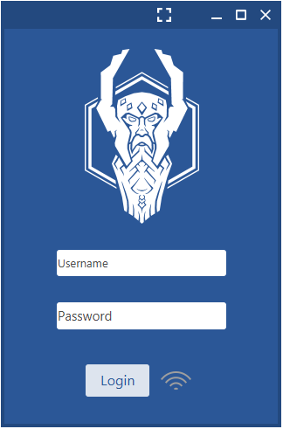
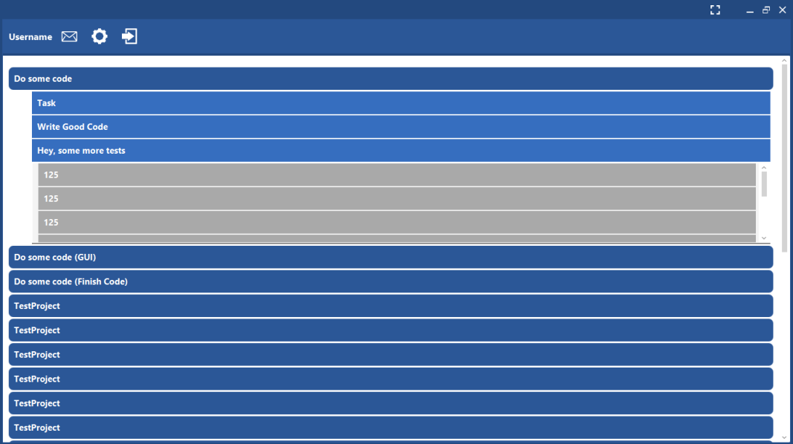
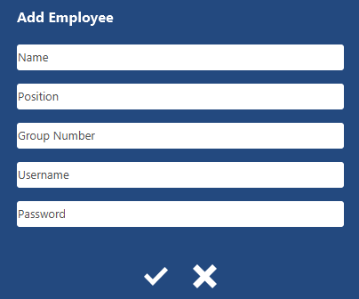
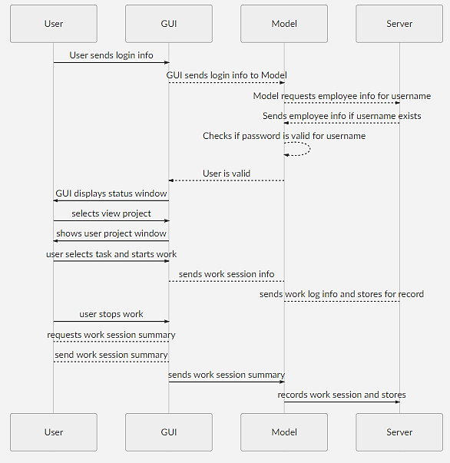
ODIN
David Henning, Ramyasri Singamsetty, Charles Foulk, Joel Sanchez, Yusuf Amani
Section 3 –Team 3 – Professor Posnett – CSC 131 – Spring 2018
ABSTRACT
ID | PRIORITY | REQUIREMENT
REQ1 | 5 | The system will store all task and project data to a SQL database for future access.
REQ2 | 2 | The system will allow access to only the authorized users through a user login page.
REQ3 | 4 | The system will allow for the creation and modification of projects as a container for tasks.
REQ4 | 1 | The system will allow administrative users to create and manage temporary logins for new users.
REQ5 | 3 | The system shall allow authorized users to create and assign tasks for other users.
REQ6 | 2 | The system shall allow users to redefine tasks (description and size).
REQ7 | 1 | The system shall allow users to change their login information.
REQ8 | 4 | The system will allow users to start and stop a task and log subsequent information associated with the action.
REQ9 | 2 | The system will keep track of user created projects and associated tasks for generating user statistics and reports.
REQ10 | 3 | The system will provide statistics on available task and project data. Such as, minimum time, maximum time, average time, durations etc.
REQ11 | 1 | The system shall display messages set by authorized users ("Your performance is subpar and you are risking termination, fyi") on login.
REQ12 | 2 | The system will limit project and task view to users specific to that project.
REQ13 | 1 | The system will notify authorized users (project lead) when a task is marked as complete by regular user (employee) on login.
REQ14 | 3 | The system will allow authorized users to conclude items such as projects and tasks to prevent access to sub-users
DASHBOARDS
Odin is a project management software designed for use by small technical businesses to help organize their work towards large goals. The leadership based structure allows for different responsibilities to be held by different workers. Managers organize the Project Leads who manage the employees. Managers create, delete, and define projects. Project leads give tasks to employees to work towards the project. Employees log their work through starting, stopping, and summarizing.
OVERVIEW
Employees can work on tasks and describe the work they have done. Task information including the start and stop time are stored in the worklog.
Project Leads can create Tasks inside of a Project for Employees to work on
The Manager can create a Project an Employee, manage Project Leads and Employee Login information
TECHNOLOGIES
SEQUENCE DIAGRAM
MYSQL
JavaFX
JFoenix
FXML
Scene Builder

Slide 2
ARCHITECTURE
Odin will be used to manage the progression of Projects. We used JavaFX for a GUI and Jfoenix for material design. We are storing our project data using an SQL Database. We have be implemented a login system that stores the user login information. Each project has its own data, so only tasks related to that project will be held together.

